Slide 1

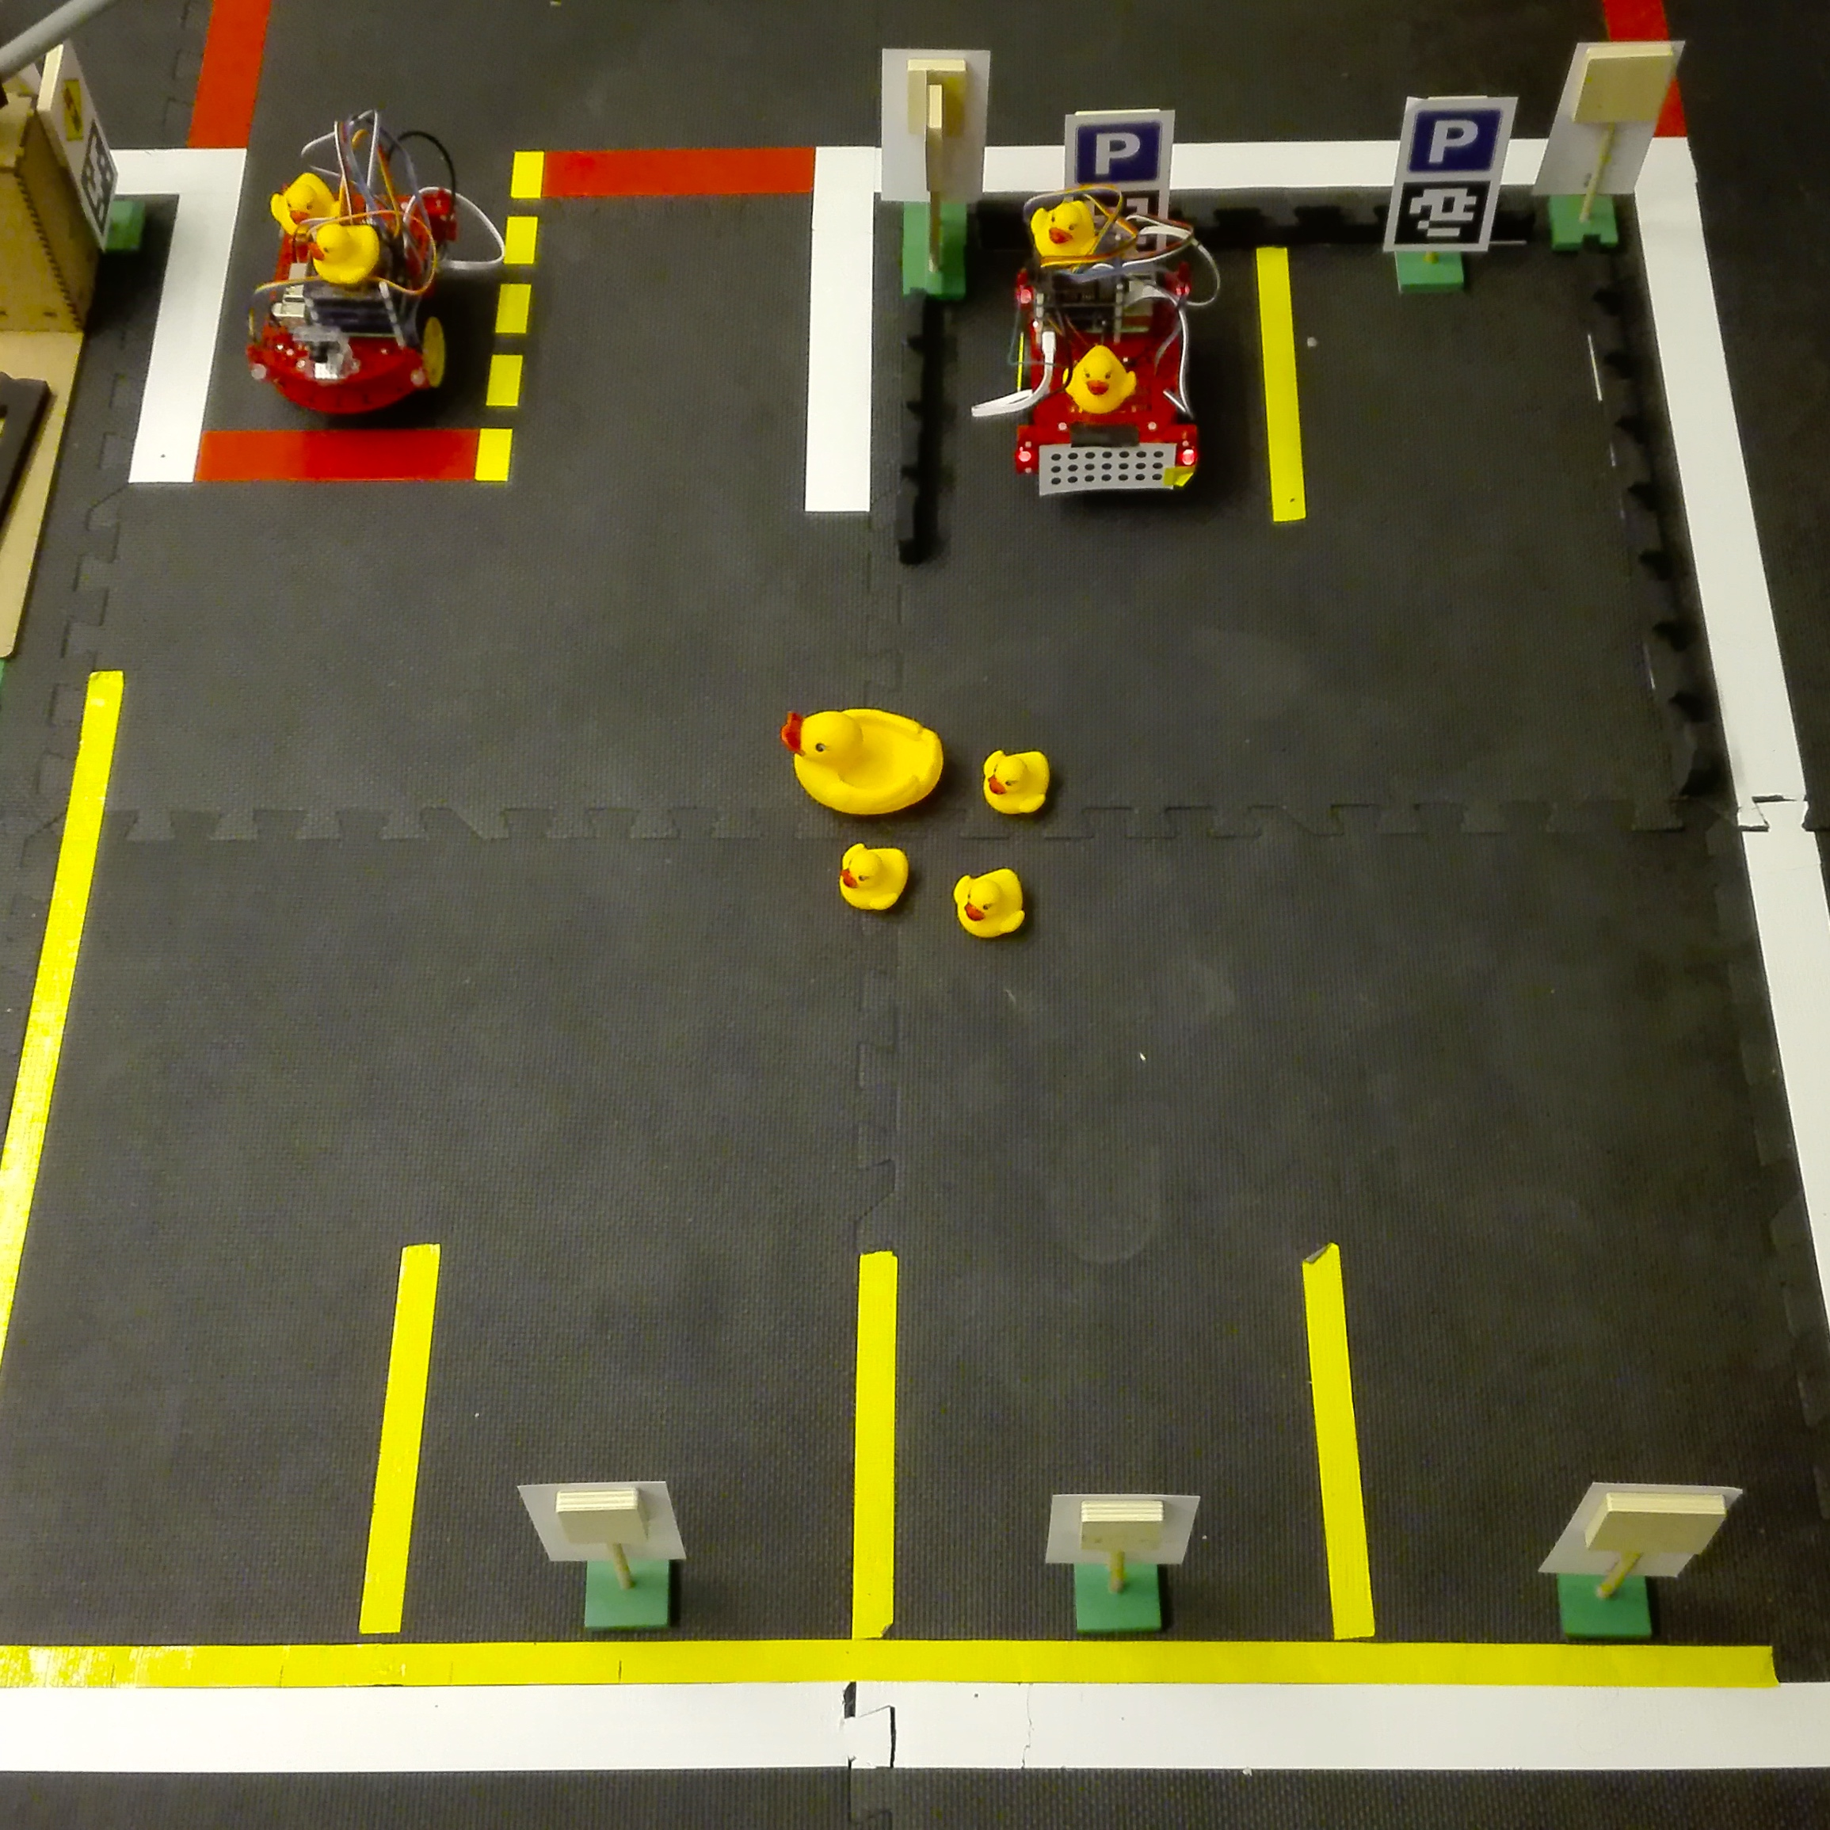
Parking: Autonomous parking in Duckietown
Samuel Nyffenegger, Brett Stephens, Nils Funk
A
Data: We produced a parking lot map with entrance, exit, six parking spaces and pre defined obstacles (non-driveable region is in magenta). A path from start pose to end pose has to be found where car-like dynamics (minimum curvature assumption) have to be preserved.
Problem: We need to park n Duckiebots autonomously in a designated area in which they are able enter and exit in an efficient manner. A path for the arriving Duckiebot will be calculated.
Approach / Algorithm: After the problem is initialized, a path is computed using Dubins curves. A collision checker verifies if the path is a collision free path inside the parking lot. If yes, the problem is solved and the solution is optimal. If not, a second stage is introduced where rapidly-exploring random tree with graph optimization (RRT*) and Dubins curves for steering are applied. The found path converges at infinity to the optimal one in presence of obstacles.
Result: left: green Dubins path (0→2), right: found RRT* path (0→4) (green) with all sub paths (yellow), dubins path (magenta) crashes into duckies

